Slide 1
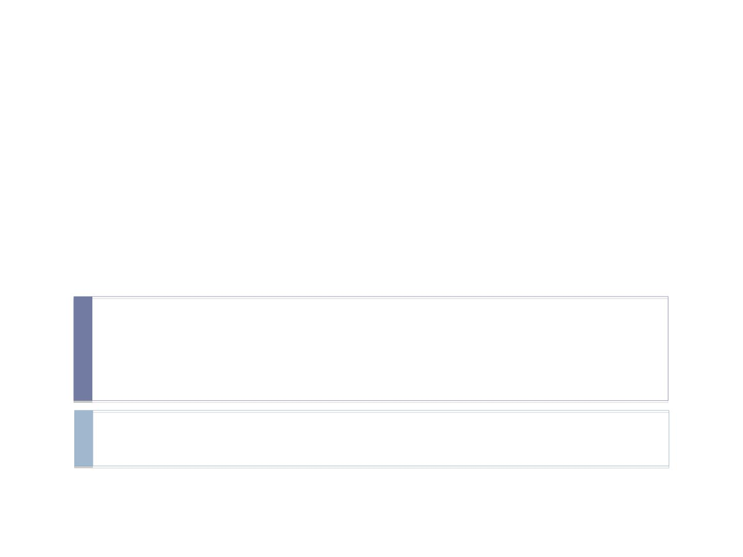
Spring MVC 5.x
Rajeev Gupta MTech CS
Java Trainer

Slide 2
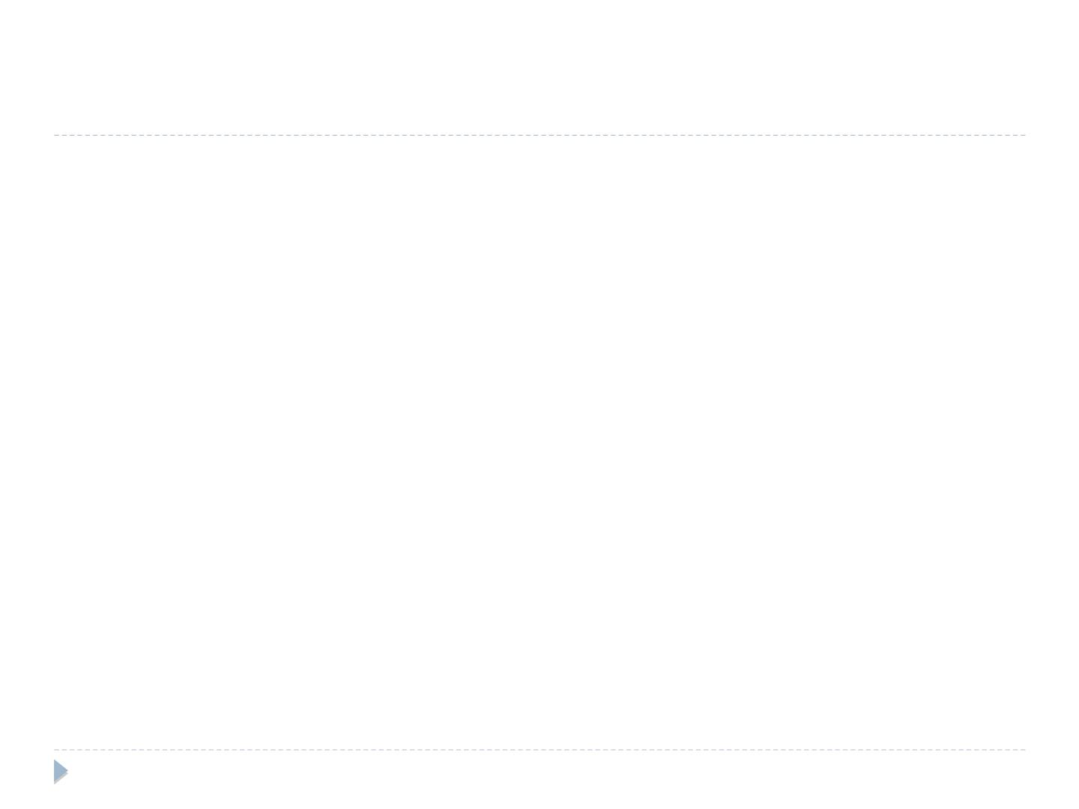
Spring 5 MVC

Spring MVC Architecture

Spring MVC Example

Spring MVC annotations

Form processing

Form validation

PRG pattern

Flush attribute
Model mapper
rgupta.mtech@gmail.com

Slide 3
Spring MVC Architecture

Slide 4
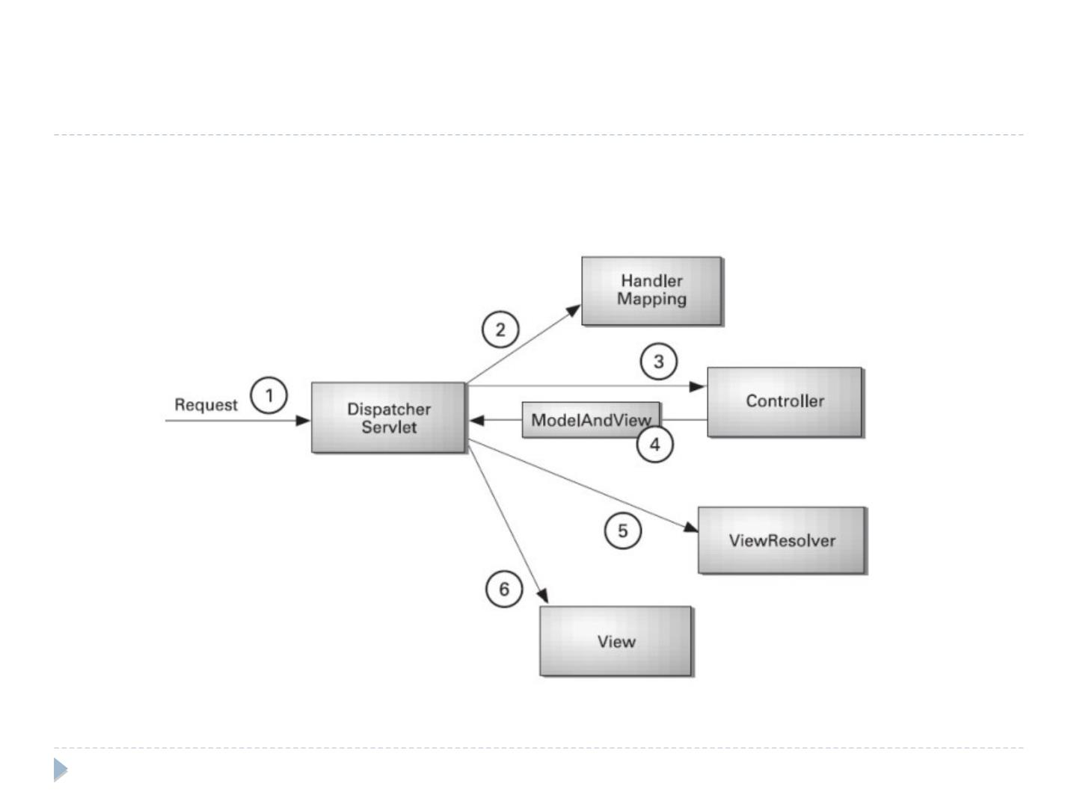
Spring MVC basic Architecture
rgupta.mtech@gmail.com

Slide 5
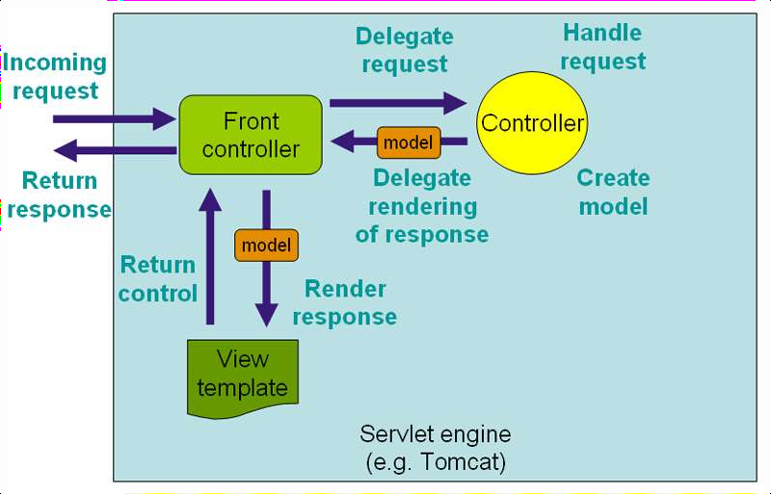
DispacherServlet
The
DispatcherServlet
is an actual Servlet
(it inherits from the
HttpServlet base
class), and as such is
declared in your web application

Slide 6
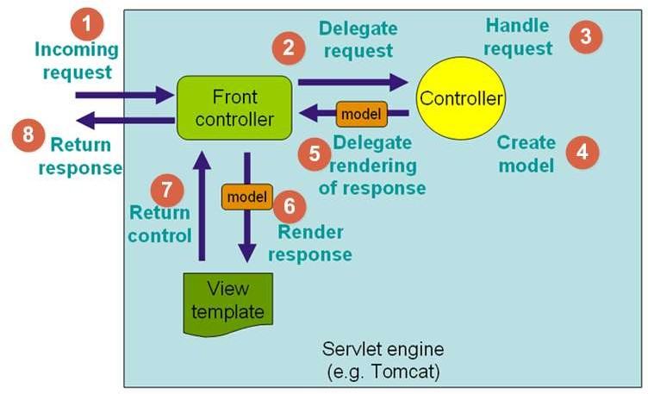
Any incoming request that comes to the web application will be sent to Front Controller (Dispatcher Servlet)
Front Controller decides to whom (Controller) it has to hand over the request, based on the request headers.
Controller that took the request, processes the request, by sending it to suitable service class.
After all processing is done, Controller receives the model from the Service or Data Access layer.
Controller sends the model to the Front Controller (Dispatcher Servlet).
Dispatcher servlet finds the view template, using
view resolver and send the model to it.
Using View template, model and view page is build and sent back to the Front Controller.
Front controller sends the constructed view page to the browser to render it for the user requested.

Slide 7
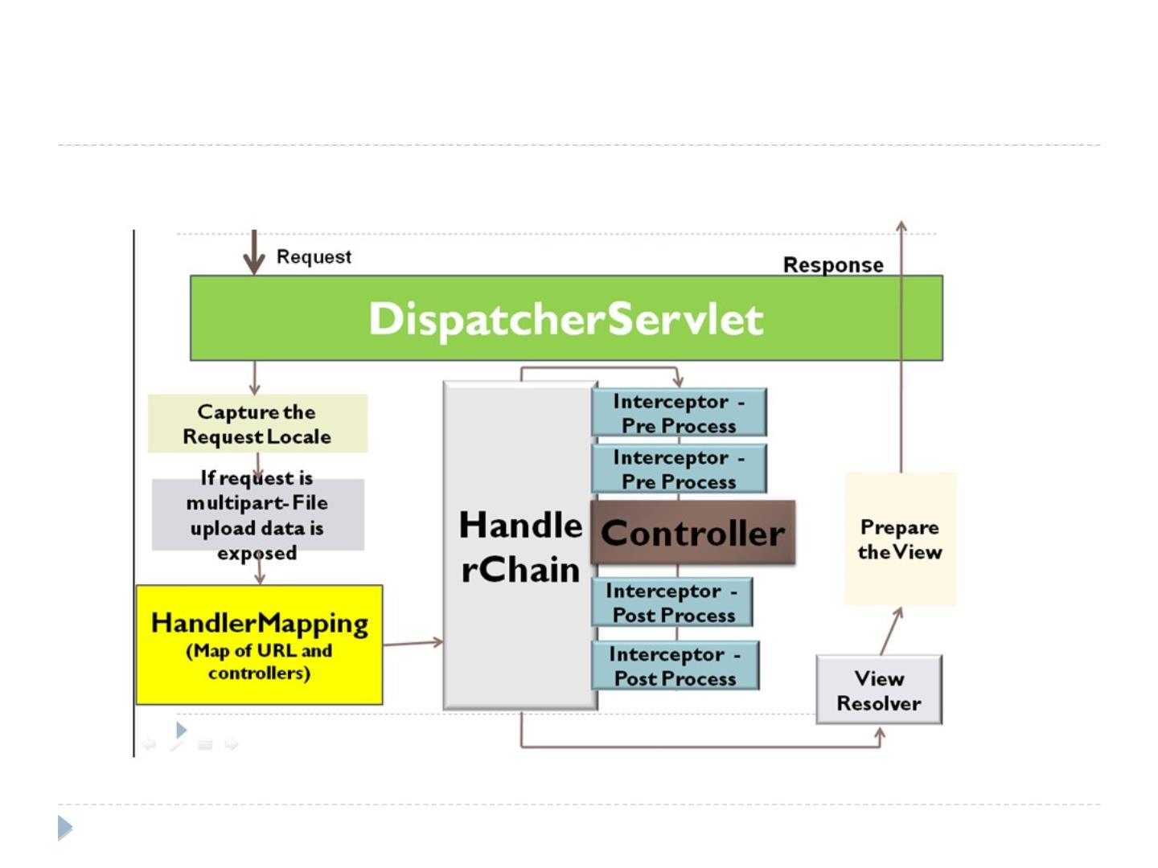
Spring MVC request ﬂow
rgupta.mtech@gmail.com

Slide 8
Spring MVC request ﬂow

DispatcherServlet receives the request for a URL in the application.

The Locale Resolver component will look for the the Locale information in the request
header or session or Cookie as the conﬁguration. The Locale is used to pick the resource
ﬁles based on the language of the user. This Locale Resolver plays a key role in
internationalization of the application.

The Theme Resolver is bound to the request to make the views determine which
theme/CSS needs to be applied.

The Multipart Resolver component is invoked to check if the request is for a ﬁle upload
and then wraps the request to facilitate the ﬁle upload functionality.

The Handler mapping component is invoked on the request to get the respective
controller which is responsible to handle this request.

The DispatcherServlet then invokes the HandlerChain which will execute the following:

Checks if there are any interceptors mapped and invokes the Pre Processing logic.

The controllers handler method will be invoked where the request is processed and the result is
returned.

The mapped interceptors post processing logic will be invoked

The DispactherServlet based on the result returned by the Controllers handlers
method, the ResutlToViewNameTranslator component is invoked to generate the view
name.

The view resolver will then decide on what view needs to be rendered
(JSP/XML/PDF/VELOCITY etc.,) and then the result will be dispatched to the client.
rgupta.mtech@gmail.com

Slide 9
Spring MVC Configuration xml

Slide 10
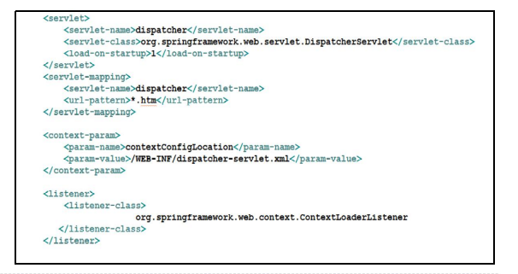
Spring MVC Conﬁguration

Step 1: Conﬁgure the web.xml with DispatcherServlet
and details of the application context ﬁle location.
rgupta.mtech@gmail.com

Slide 11
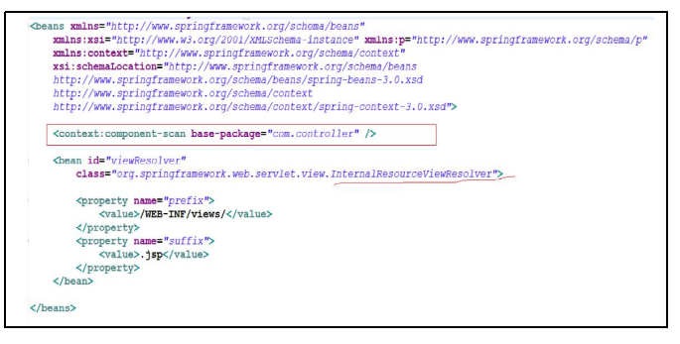
Spring MVC Conﬁguration

Step 2: Conﬁgure the dispatcher-servlet.xml
rgupta.mtech@gmail.com

Slide 12
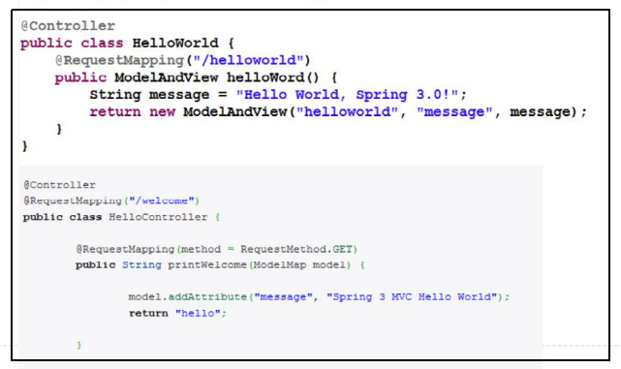
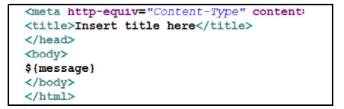
Spring MVC Conﬁguration

Step 3: Create controller and view

Slide 13
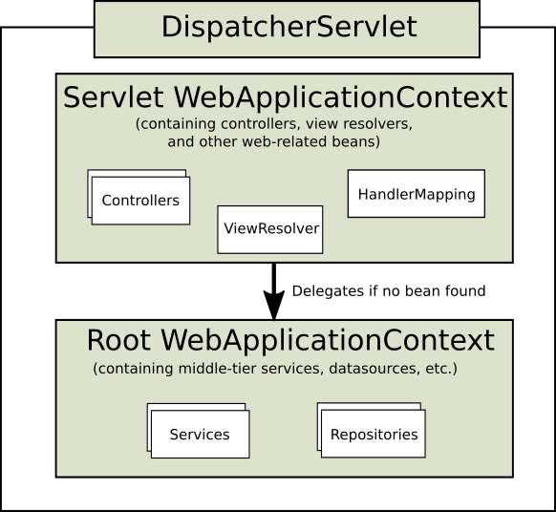
WebApplicationContext vs RootApplicatoinContext
Root Config Classes are actually used to Create Beans which are Application Specific and which needs to be available for Filters (As Filters are not part of Servlet).
Servlet Config Classes are actually used to Create Beans which are DispatcherServlet specific such as ViewResolvers, ArgumentResolvers, Interceptor, etc.
Root Config Classes will be loaded first and then Servlet Config Classes will be loaded.
Root Config Classes will be the Parent Context

Slide 14
MVC form processing

Slide 15
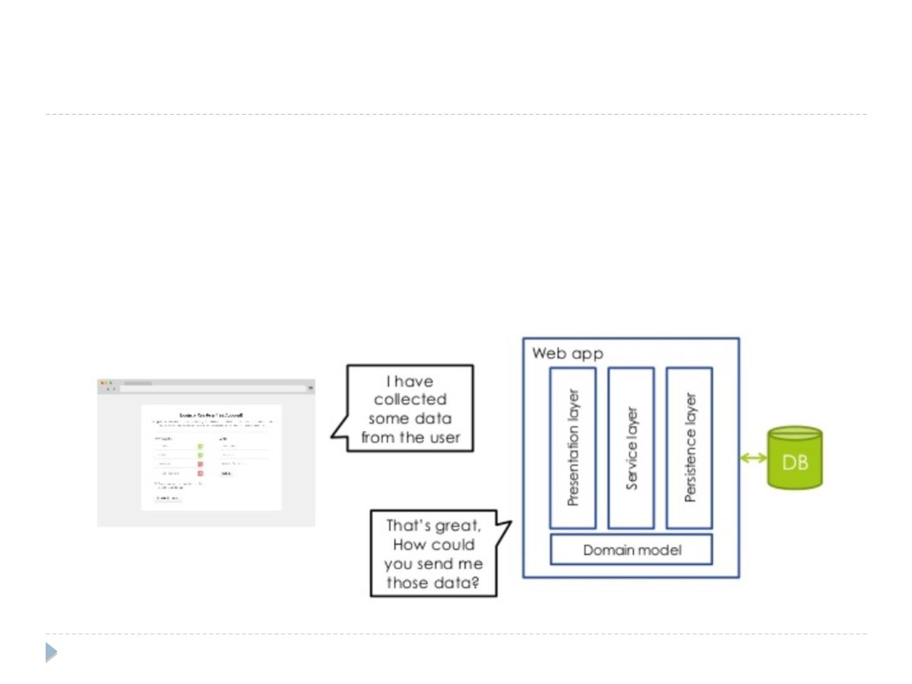
Html form vs. web applications

Html forms gives a place to enter data but do
not provide space for web app to put such
data
rgupta.mtech@gmail.com

Slide 16
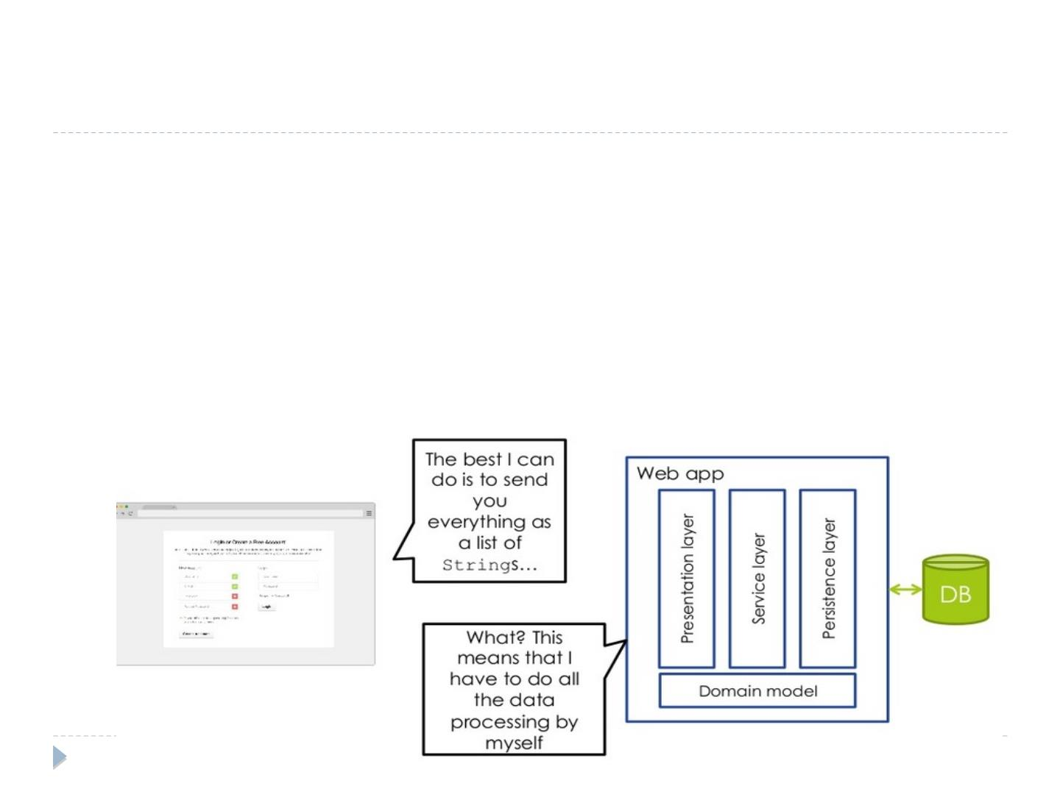
Html form vs. web applications

What happens when form submitted?

The browser send the data up to the server as a list of name value pair

Everything is going to be transferred to the web app as a String

HTTP/HTML does not provide a components that can buﬀer,
validate and convert input coming from a form

That is the way HTTP and HTML work, web applications can not control this
rgupta.mtech@gmail.com

Slide 17
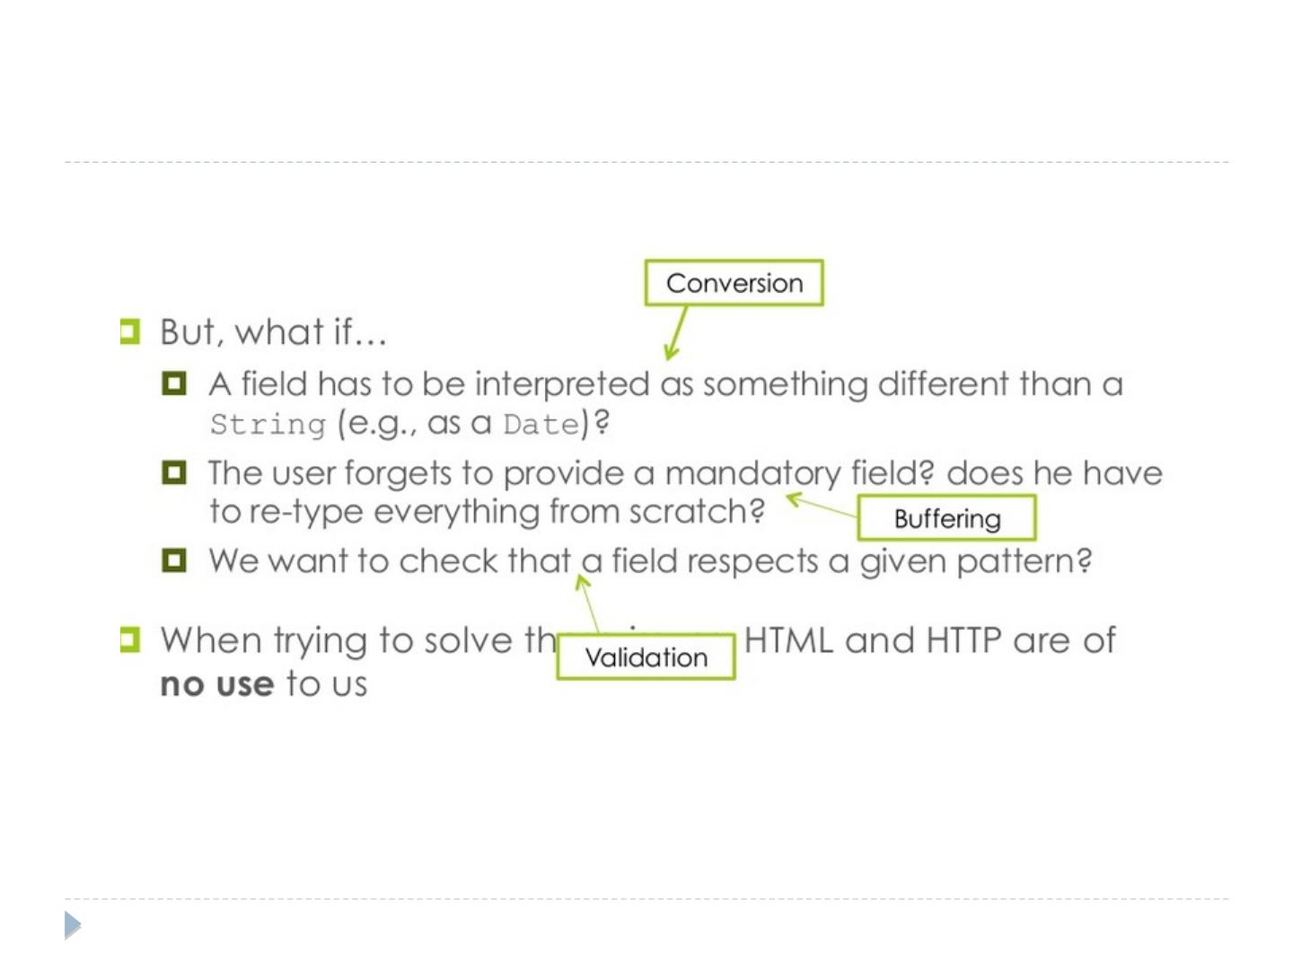
Html form vs. web applications
rgupta.mtech@gmail.com

Slide 18
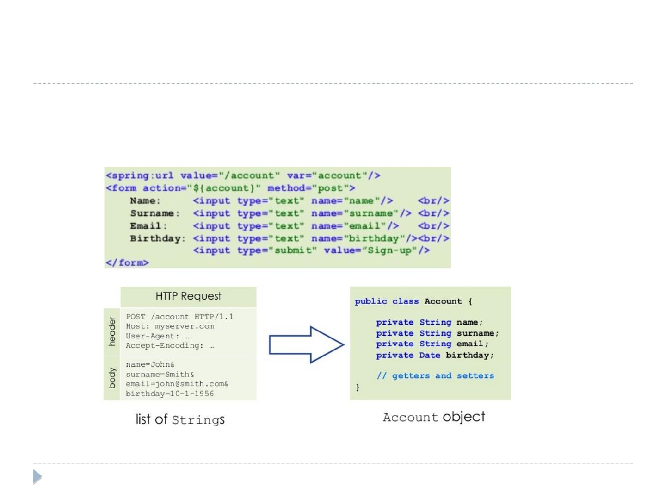
Account Sign up example: Conversion

What is the best way to move request
parameter to the account object? (backing
bean)
rgupta.mtech@gmail.com

Slide 19
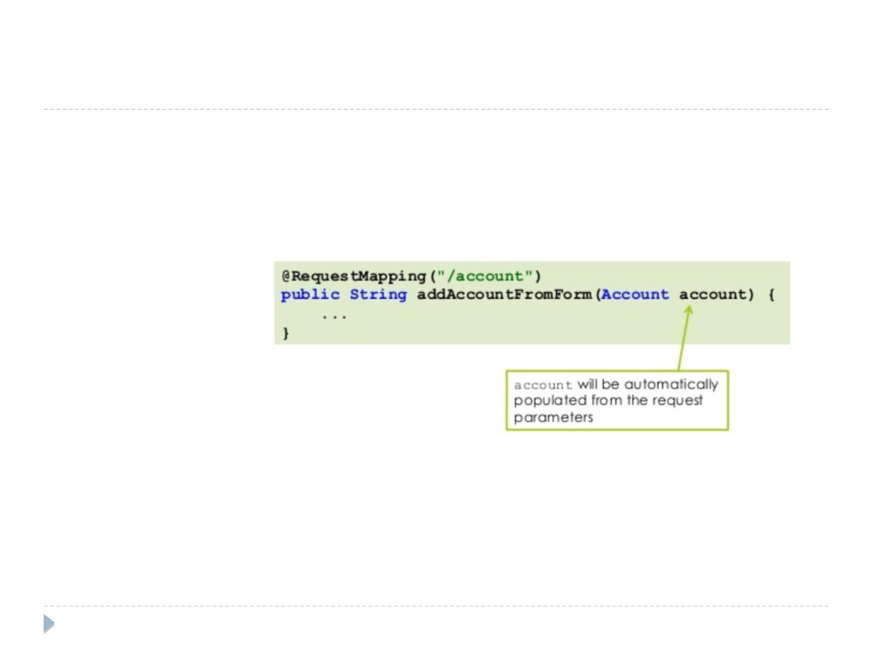
Data binding

Data binding is the process of "binding" the request
parameters to a so called form bean/backing bean

All we need to do is to declare an account object as a
method parameter.

The following sequence of operations occurs:
1. A new form bean is instantiated
2. the form bean is added to the model
3. the form bean is populated from the request parameters
rgupta.mtech@gmail.com

Slide 20
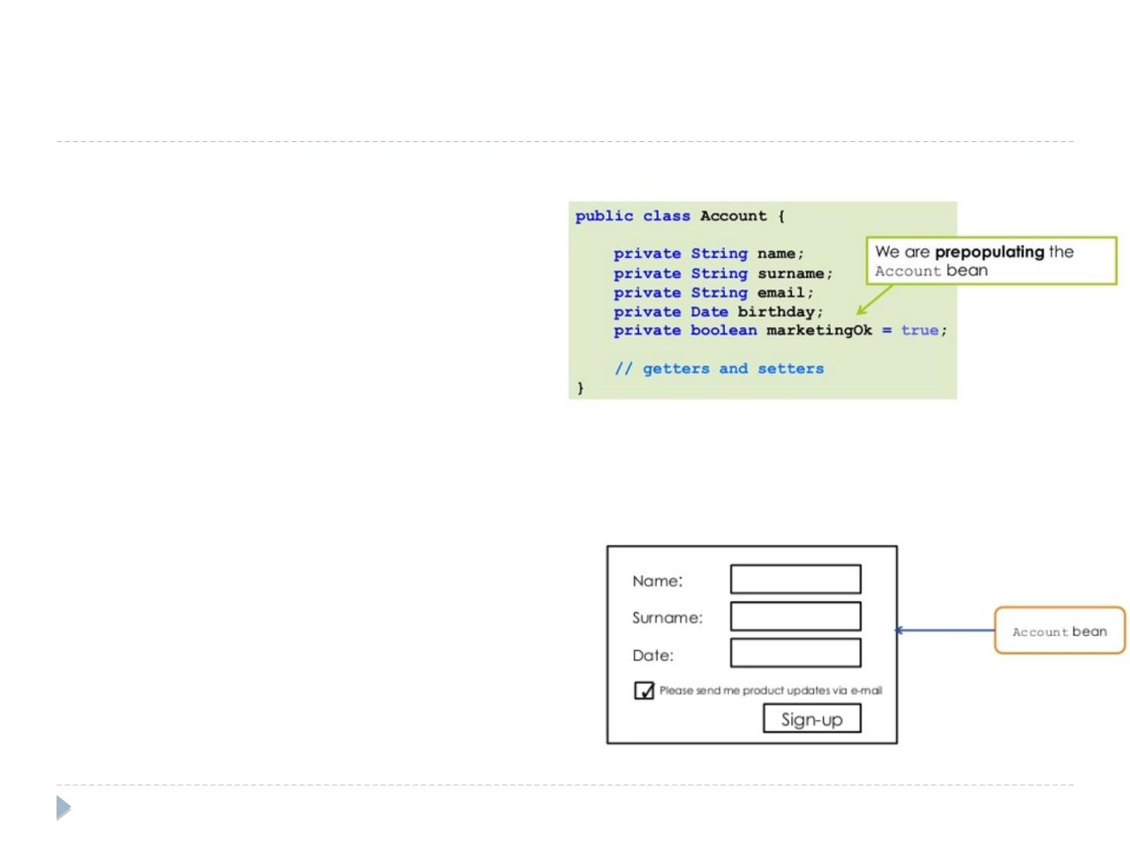
Account Sign up example: Data buﬀering
(Pre populated values)

Setting a default value
for the form bean

Assume that we want to ask
the user for the permission
of sending marketing e-mails

To this end we add a
marketingOk property in the
Account form bean

By default we want
marketingOk to be checked

We would like the
registration page to use
properties coming from a
prepopulated Account bean
rgupta.mtech@gmail.com

Slide 21
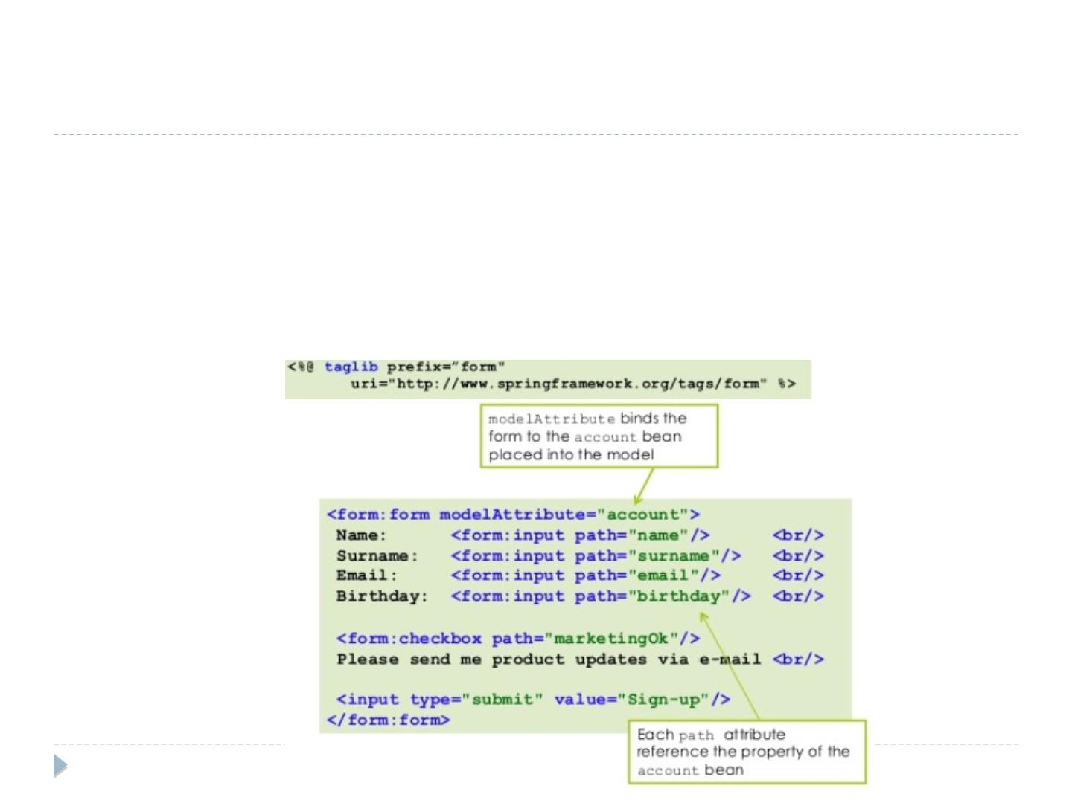
Revised registration form

To deal with pre-populated form beans, Spring provides a set
of data binding aware tags

To use the tags from the form libary, following directives
need to be added to the top of JSP

Slide 22
MVC form validation

Slide 23
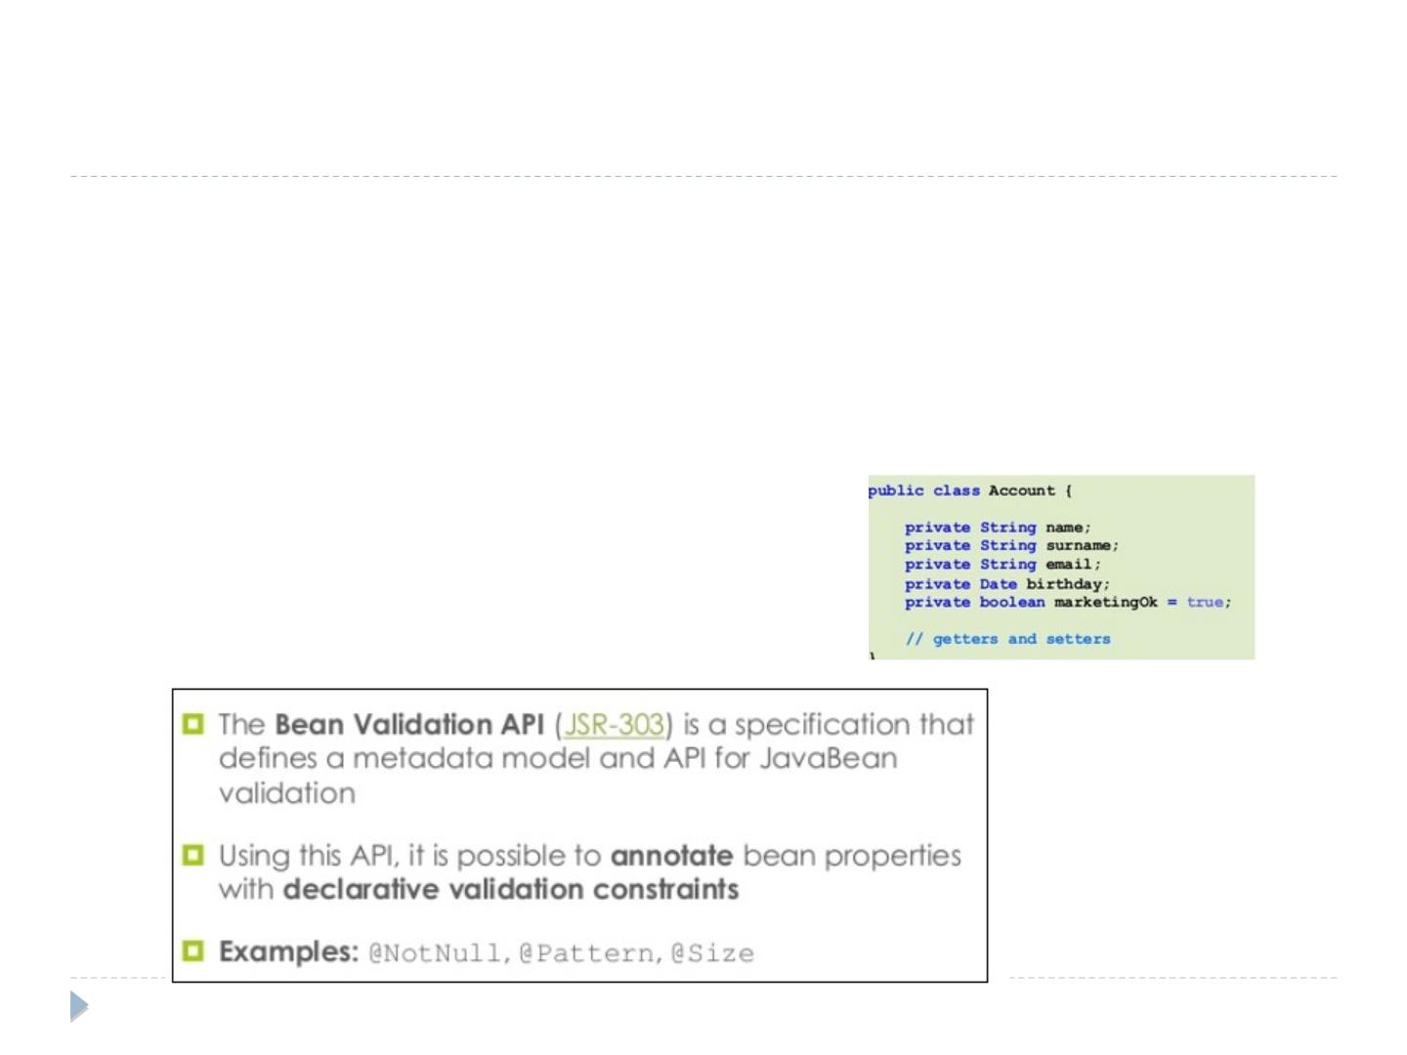
Account Sign up example: Data validation

To detect user's errors, we need to validate the
form data that are encapsulated in the form bean

Example: the email property should respect the
pattern foo@provider.com
rgupta.mtech@gmail.com

Slide 24
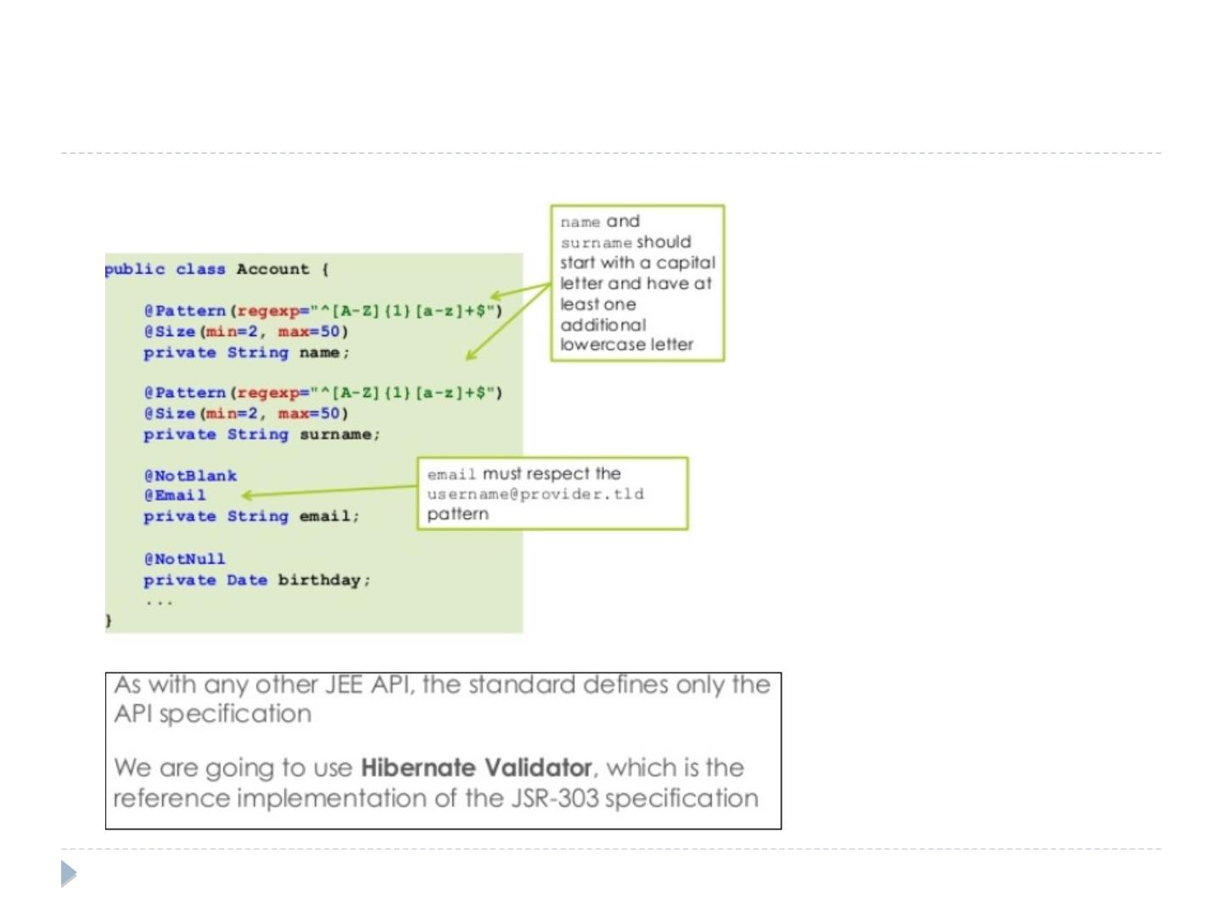
Adding constraints to the Account bean
rgupta.mtech@gmail.com

Slide 25
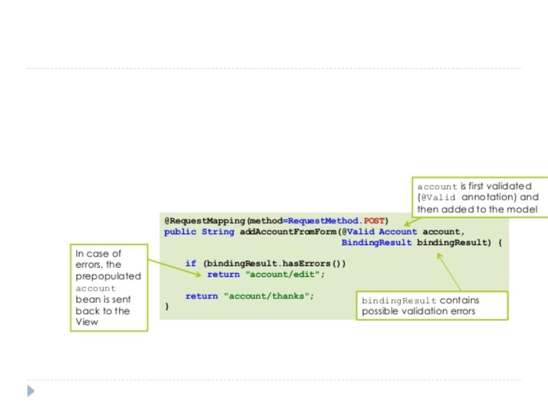
Checking for validation errors

together with the form bean, the handler
method can now receive the result of the
validation process
rgupta.mtech@gmail.com

Slide 26
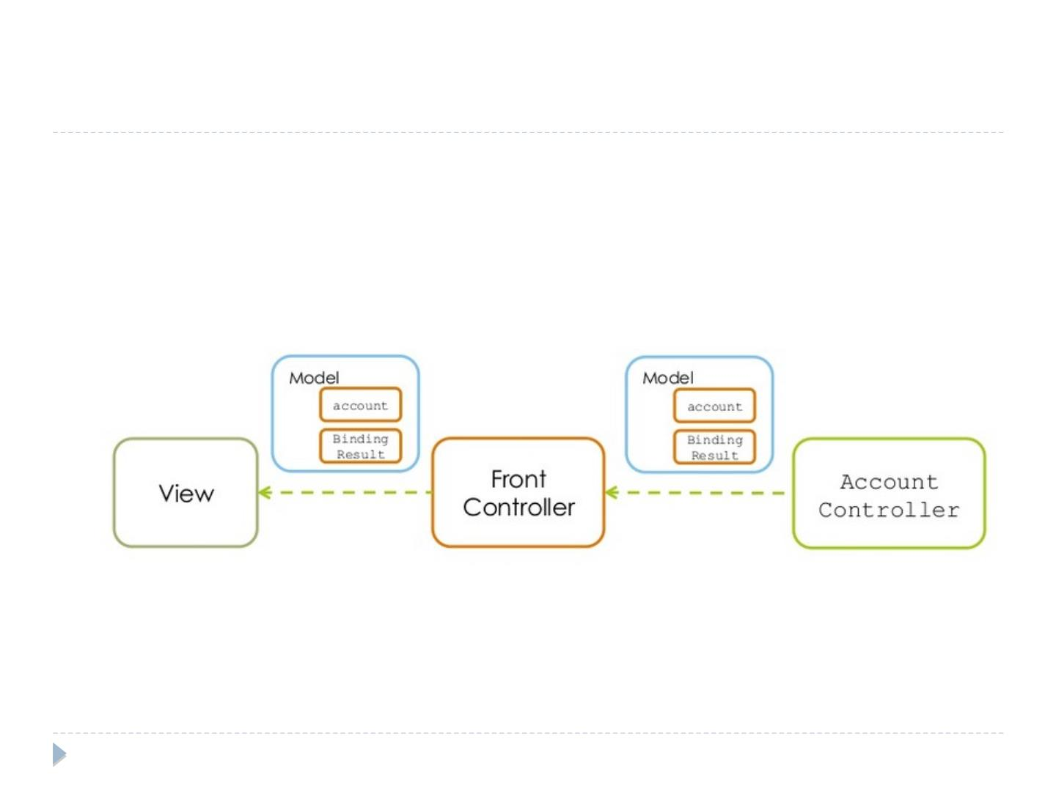
BindingResult is the part of the model

To this end the bindingResult object is
automatically inserted into the model and send
back to the view
rgupta.mtech@gmail.com

Slide 27
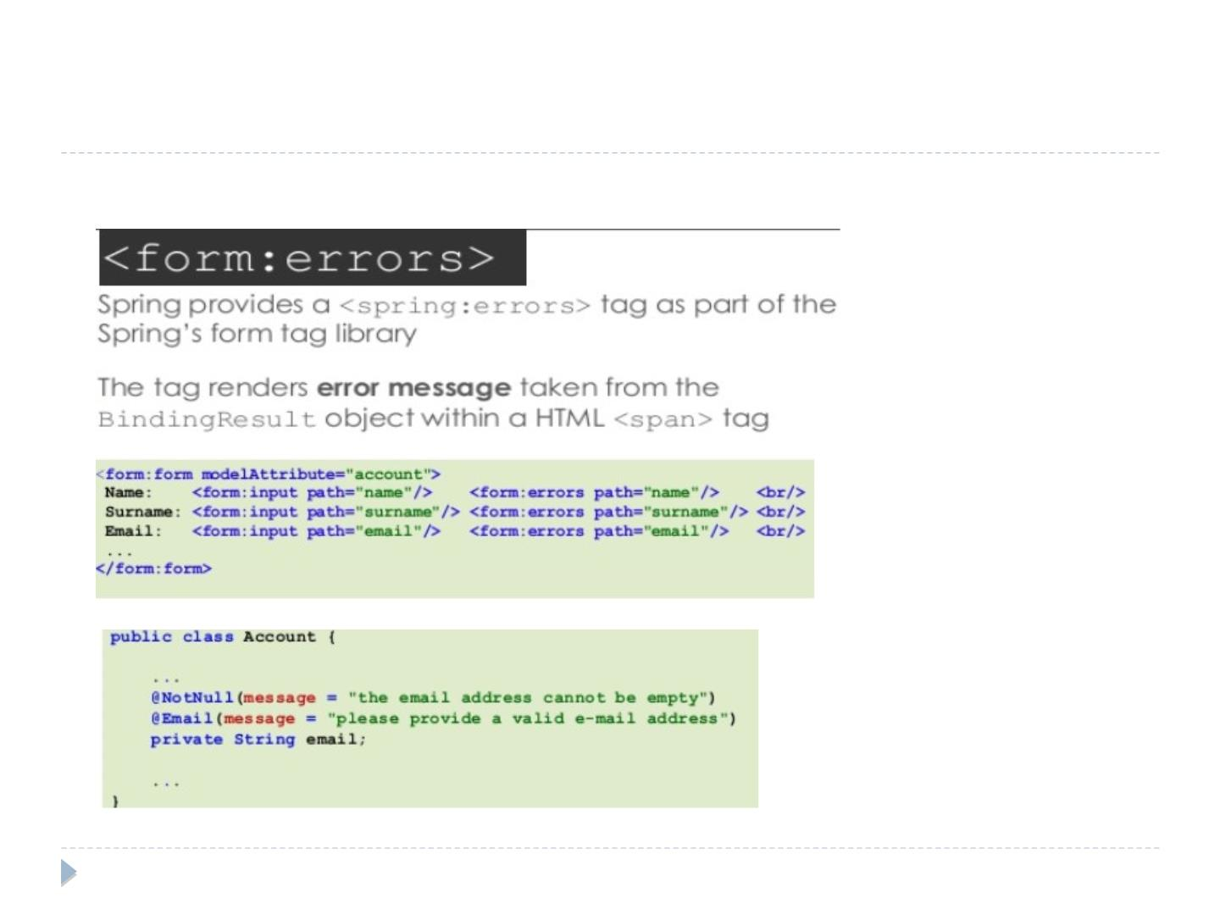
<form:errors>
rgupta.mtech@gmail.com

Slide 28
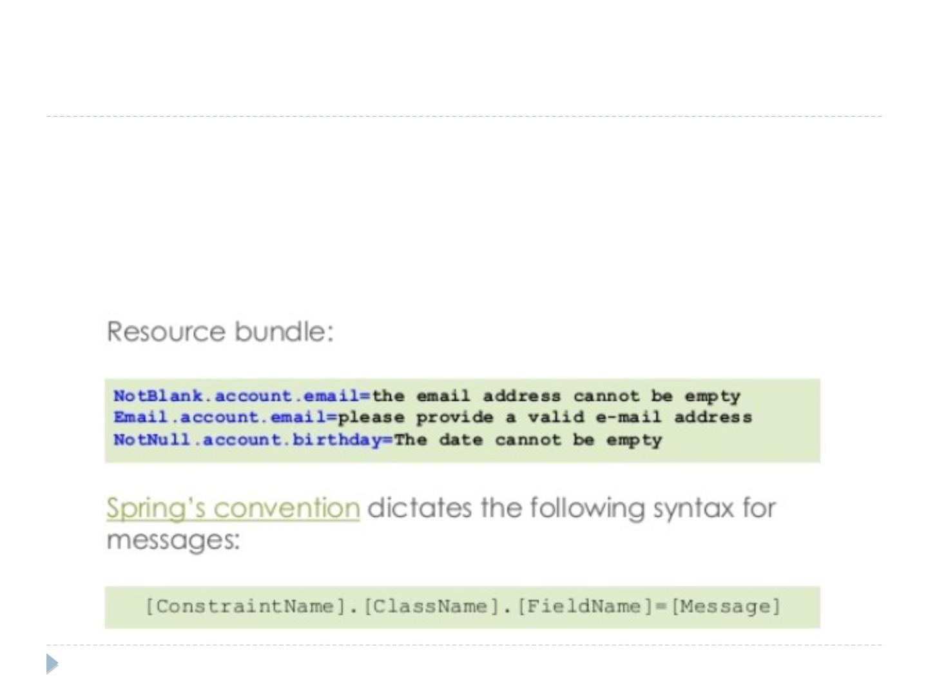
Resource Bundle

A better alternative is to store the error messages in a
separate ﬁle called the resource bundle

By doing so, error messages can be updated independently
from the source code ( loose coupling)
rgupta.mtech@gmail.com

Slide 29
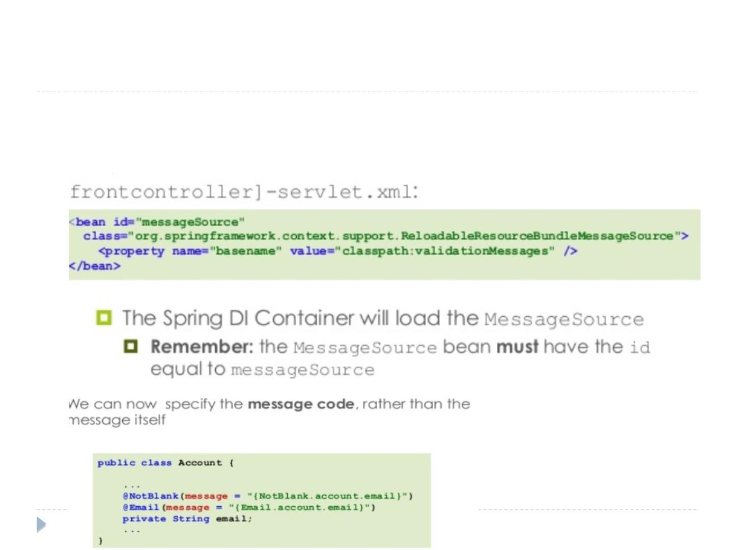

We need to declare
ReloadableResourceBundleMessageSource bean in order to
load messages from a resource bundle
com

Slide 30
PRG pattern

Slide 31
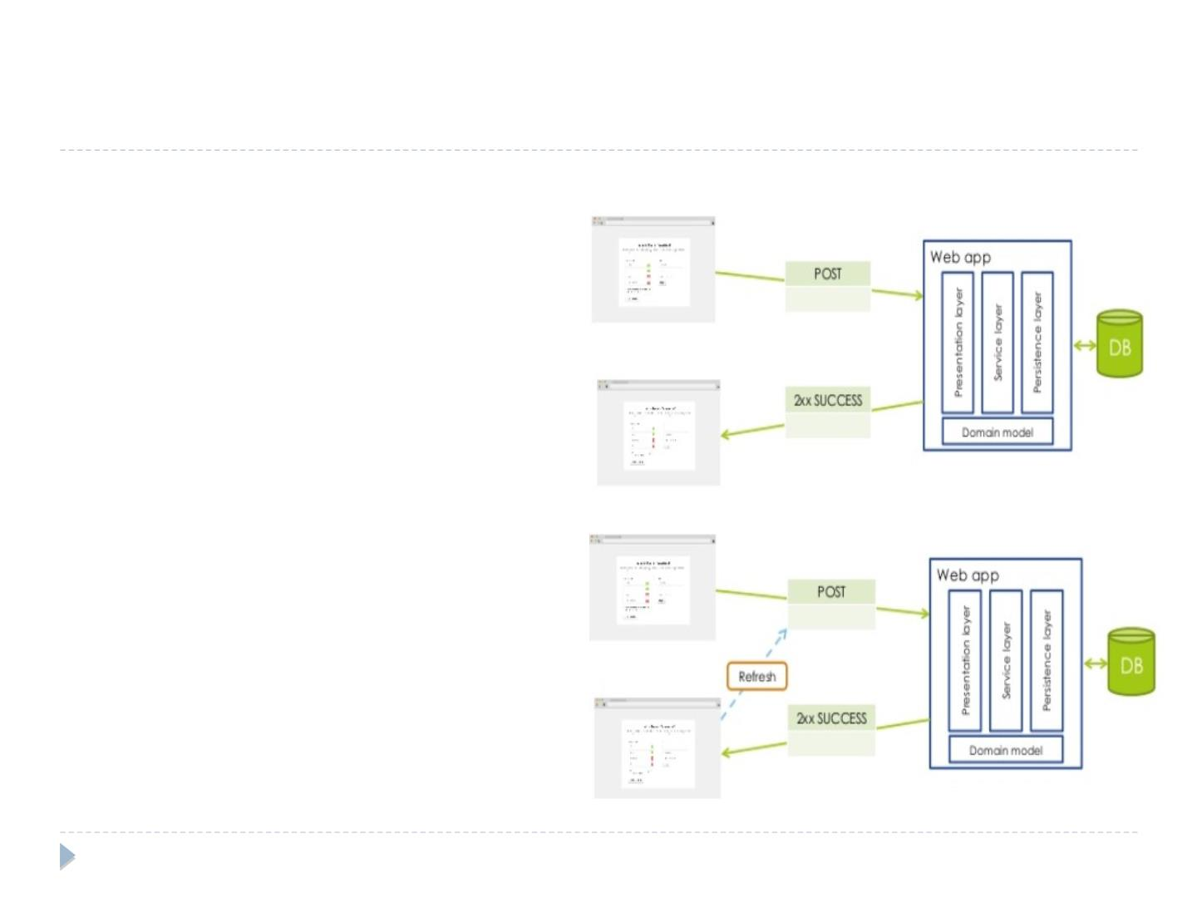
Handling User input PRG pattern

Web form are
submitted to the
server through http
POST

What if user press
refresh on the
browser?

Double form
submission
rgupta.mtech@gmail.com

Slide 32
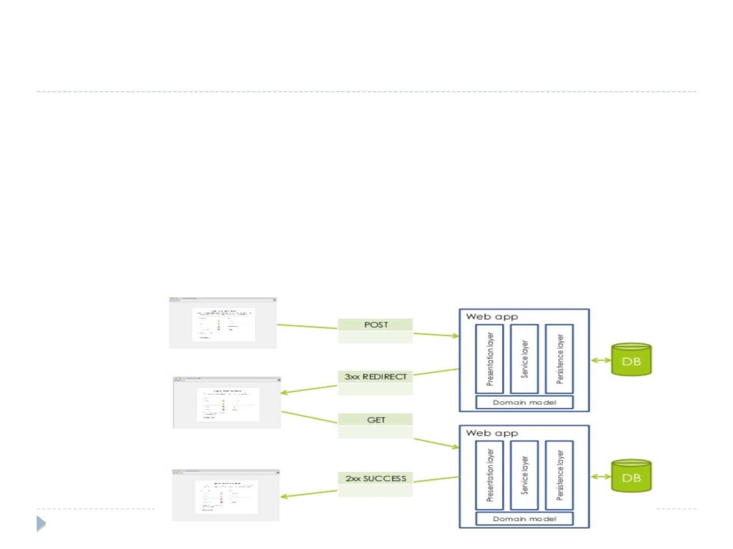
The Post/Redirect/Get design pattern

The PRG pattern solve the duplicate submission problem

According to the PRG pattern, the POST operation should
not return web page directly, instead a redirect will be
casted, causing an new GET operation to be executed

Upside: if the user refreshes the page, the GET request
will be send, instead of original HTTP POST

Slide 33
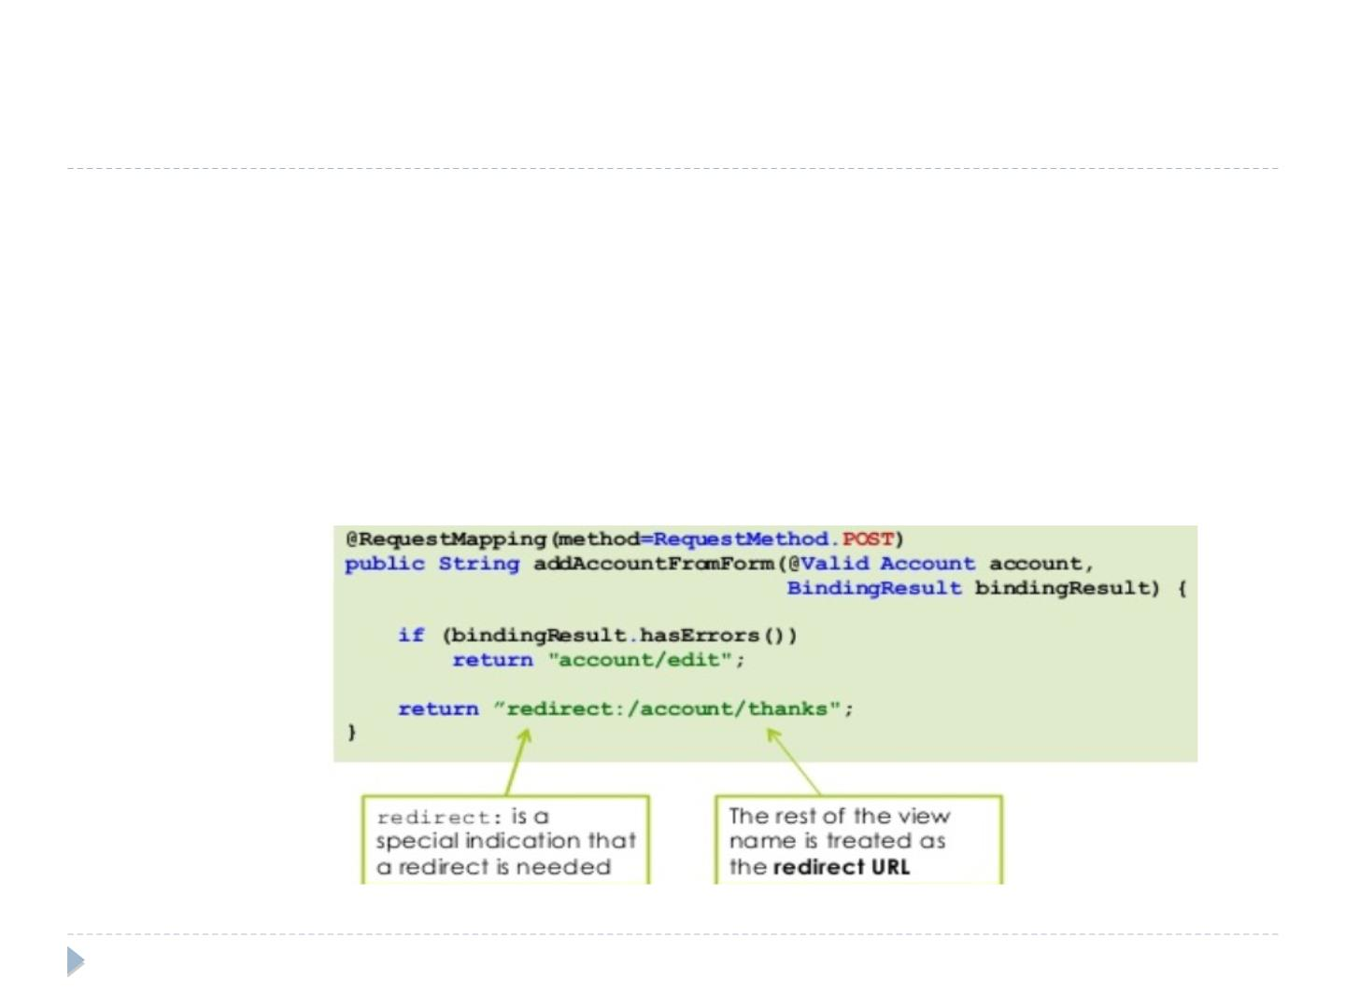
RedirectView redirect:preﬁx

To force a redirect, a controller can return RedirectView
instance

RedirectView is a special view which redirects the user to
a diﬀerent URL, rather then rendering the view itself

To return a RedirectView, it is suﬃcient to preﬁx the view
name with label redirect
rgupta.mtech@gmail.com

Slide 34
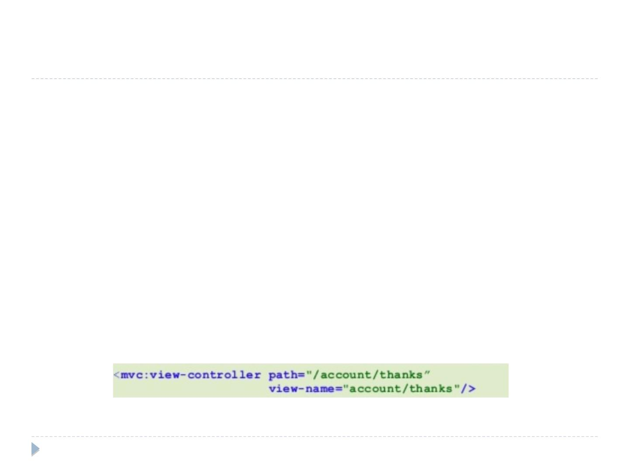
RedirectView redirect:preﬁx

Remember : what follows the redirect:preﬁx is
considered a url, not a view name

that is /account/thanks will cause a GET request to http://
myserver.com/webapp/account/thanks

hence we need a controller to handle the /account/thanks
mapping

The sole purpose of such a controller would be to return the
/account/thanks view name

That will cause the viewResolver to ﬁnally resolve the view name
to /WEB-INF/account/thanks.jsp

Starting from Spring 3, it is possible to declarative set up
controller whose unique purpose is to return a view name
in FC-servlet.xml
rgupta.mtech@gmail.com

Slide 35
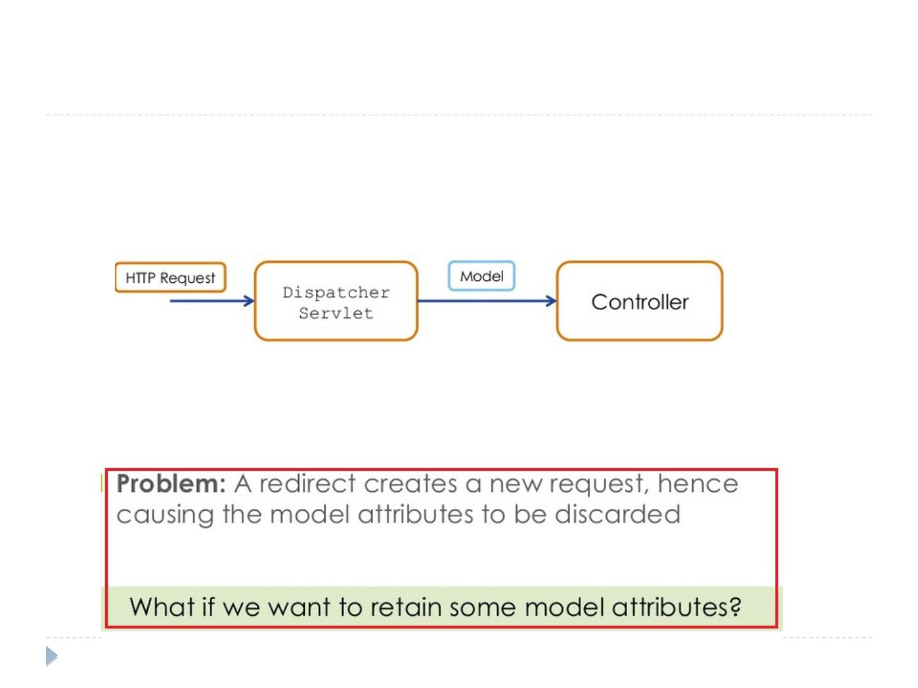
PRG pattern: Model attributes

As the model containers the data to be rendered
by the view, its lifetime is limited by the request/
response lifecycle

In other words, an new Model Object is created for each
request that hits the DispacherServlet
rgupta.mtech@gmail.com

Slide 36
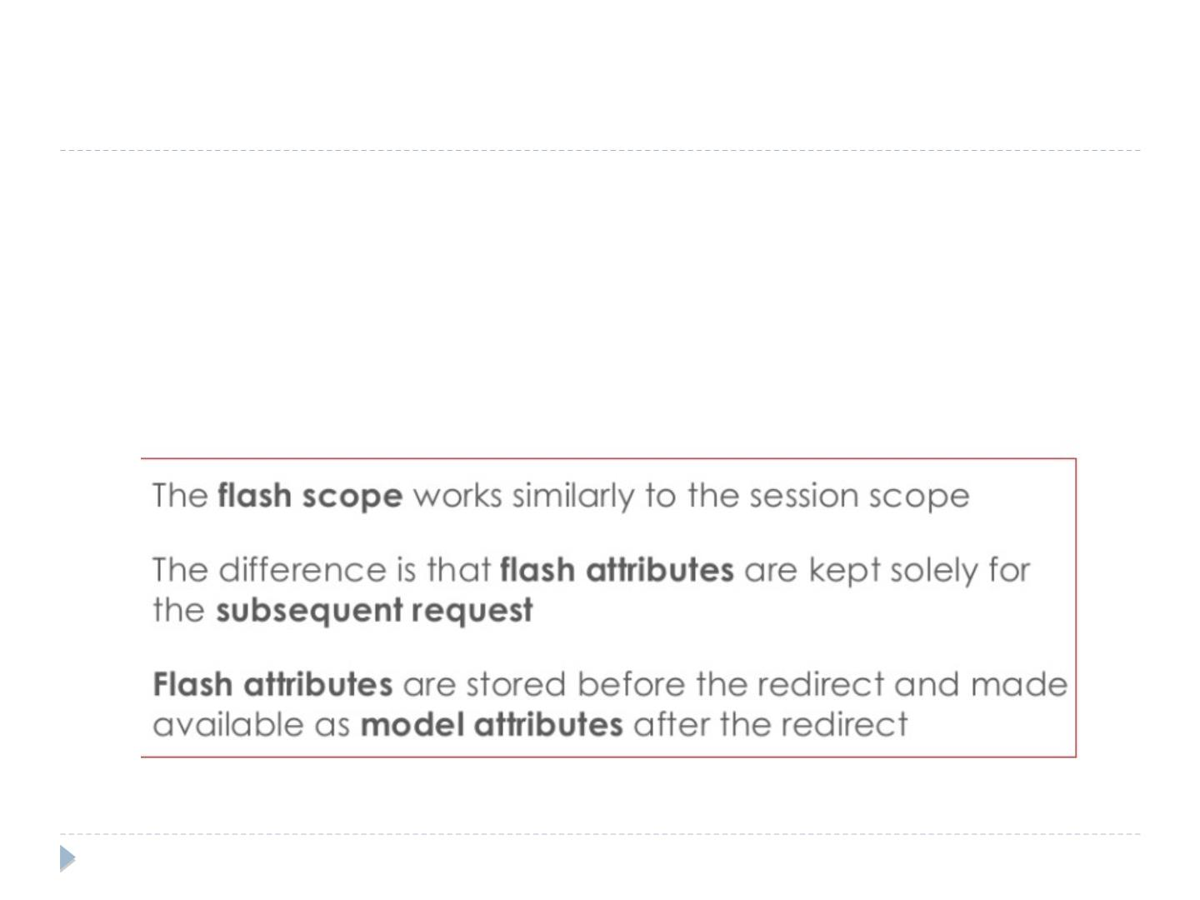
The ﬂash Scope

What if we want to retain some model
attributes?

Solution?

store attribute of interest in the ﬂash scope
rgupta.mtech@gmail.com

Slide 37
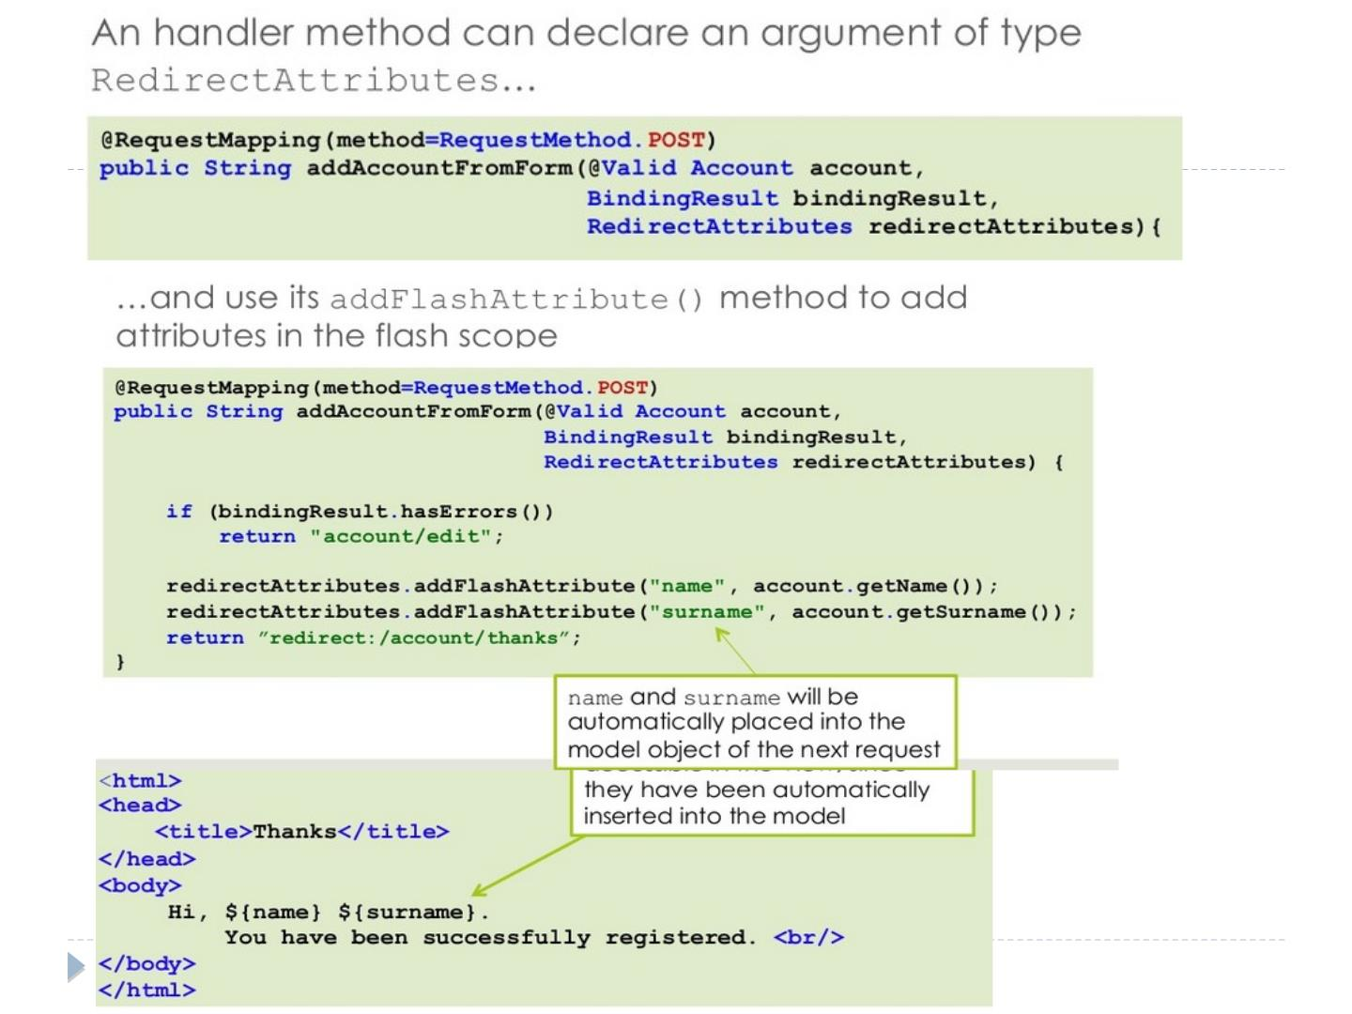

Slide 38
Spring amvc Java Configuration

Slide 39
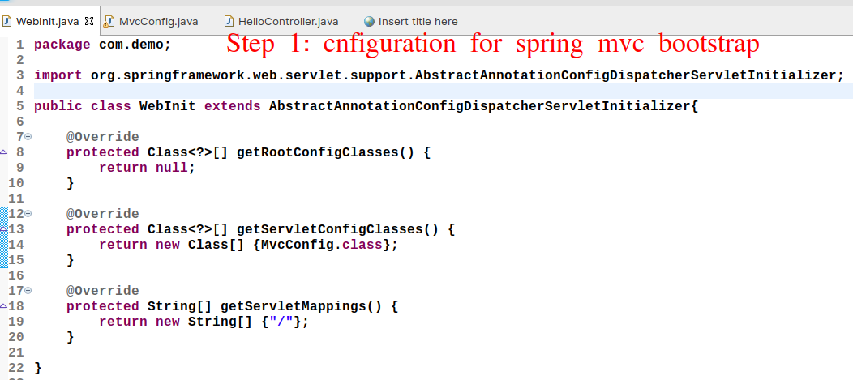

Slide 40
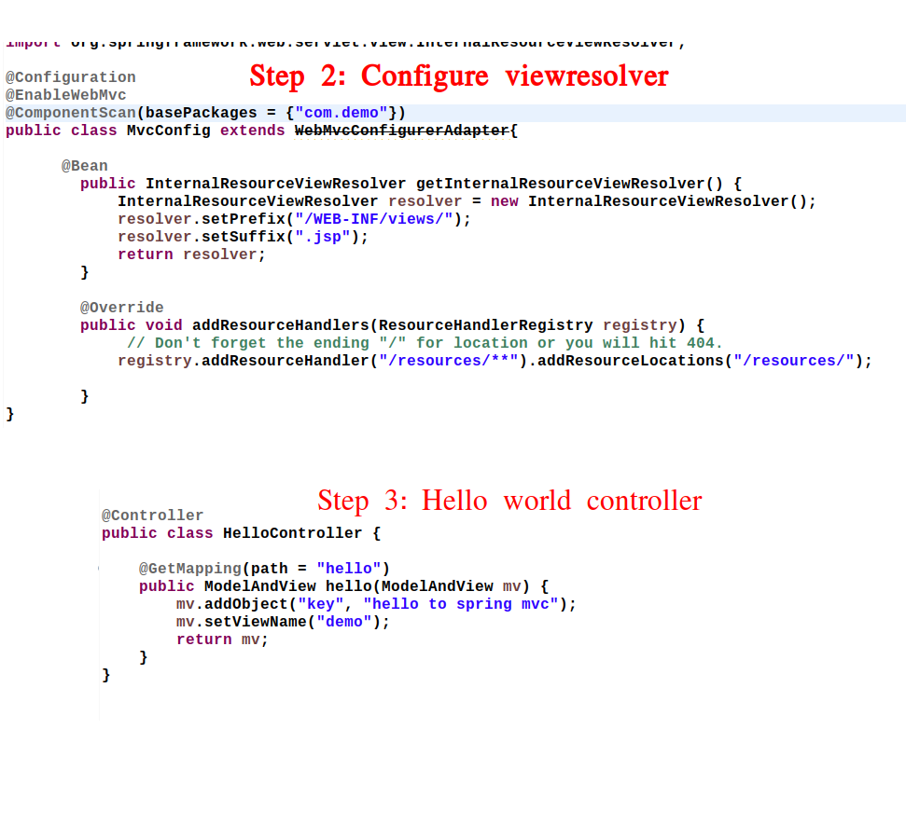

Slide 41
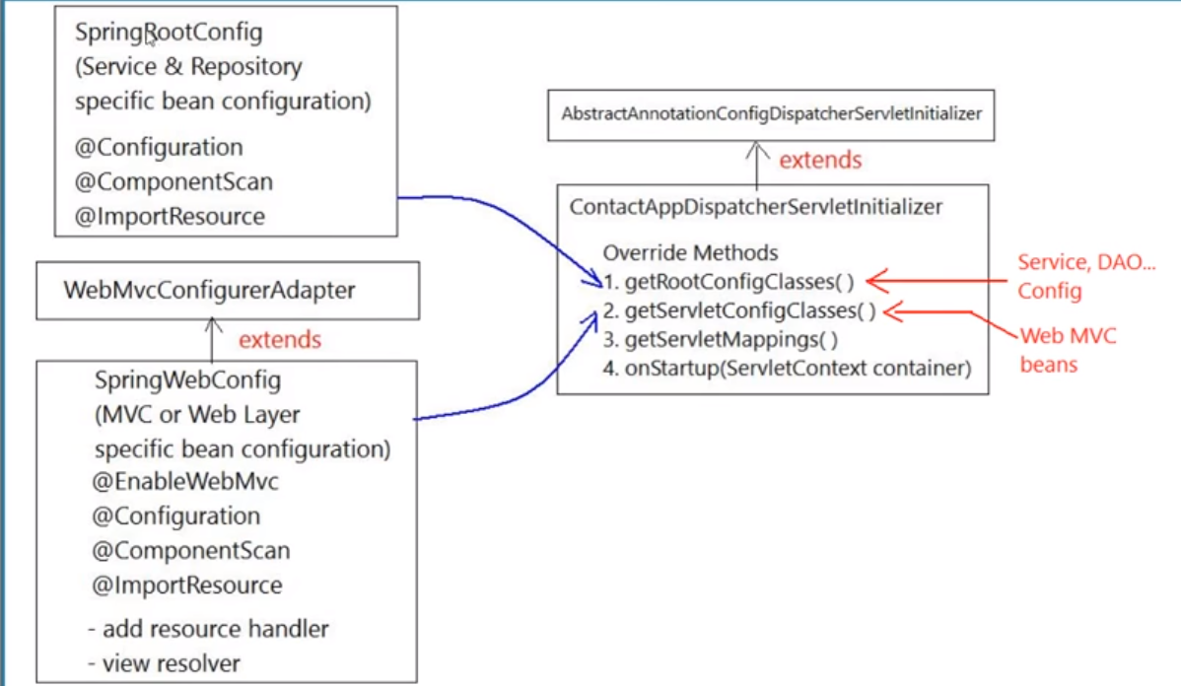
Understanding Spring Web config

Slide 42
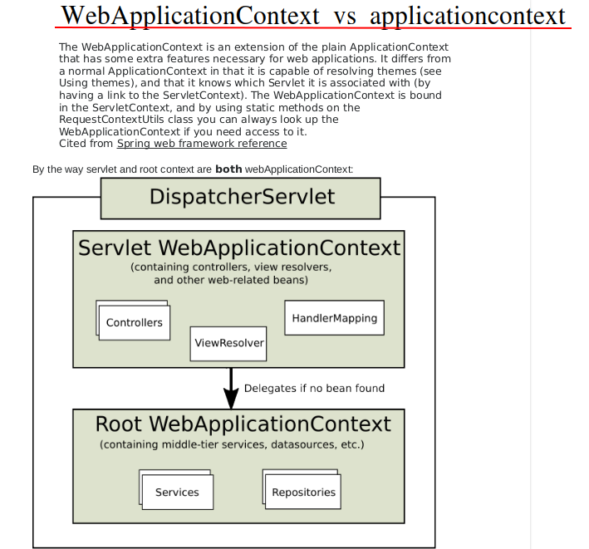
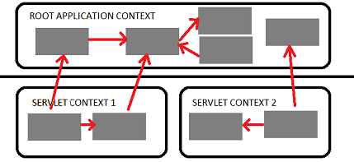

Slide 43
Model mapper

Slide 44
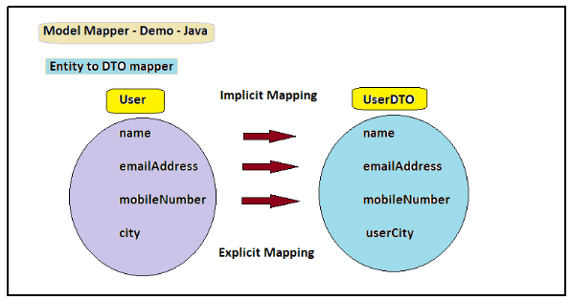
Model Mapping : Why required?

Slide 45
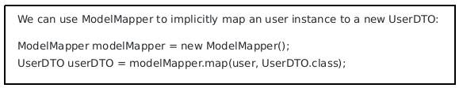
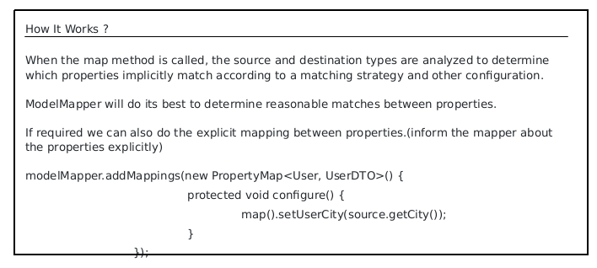
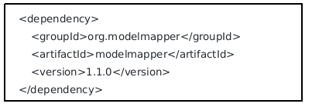
Model Mapping :Example

Slide 46
Model Mapping : Why required?

